Slide 1
PSID : 13
Problem Statement Title: Tool for monitoring ground personnel
Team Name : TRENDY BLITZ
Team Leader Name : Mithunkumar C
Institute Code (AISHE) :
Institute Name : National Engineering College,
Kovilpatti ,TamilNadu

Slide 2
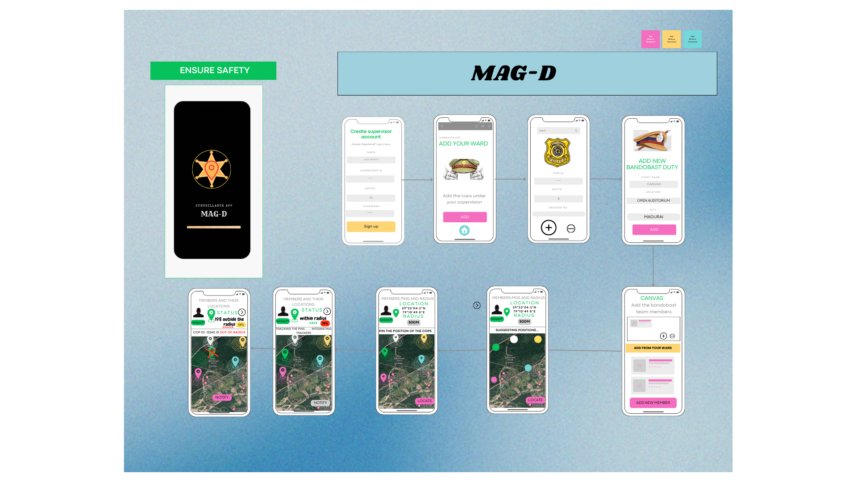
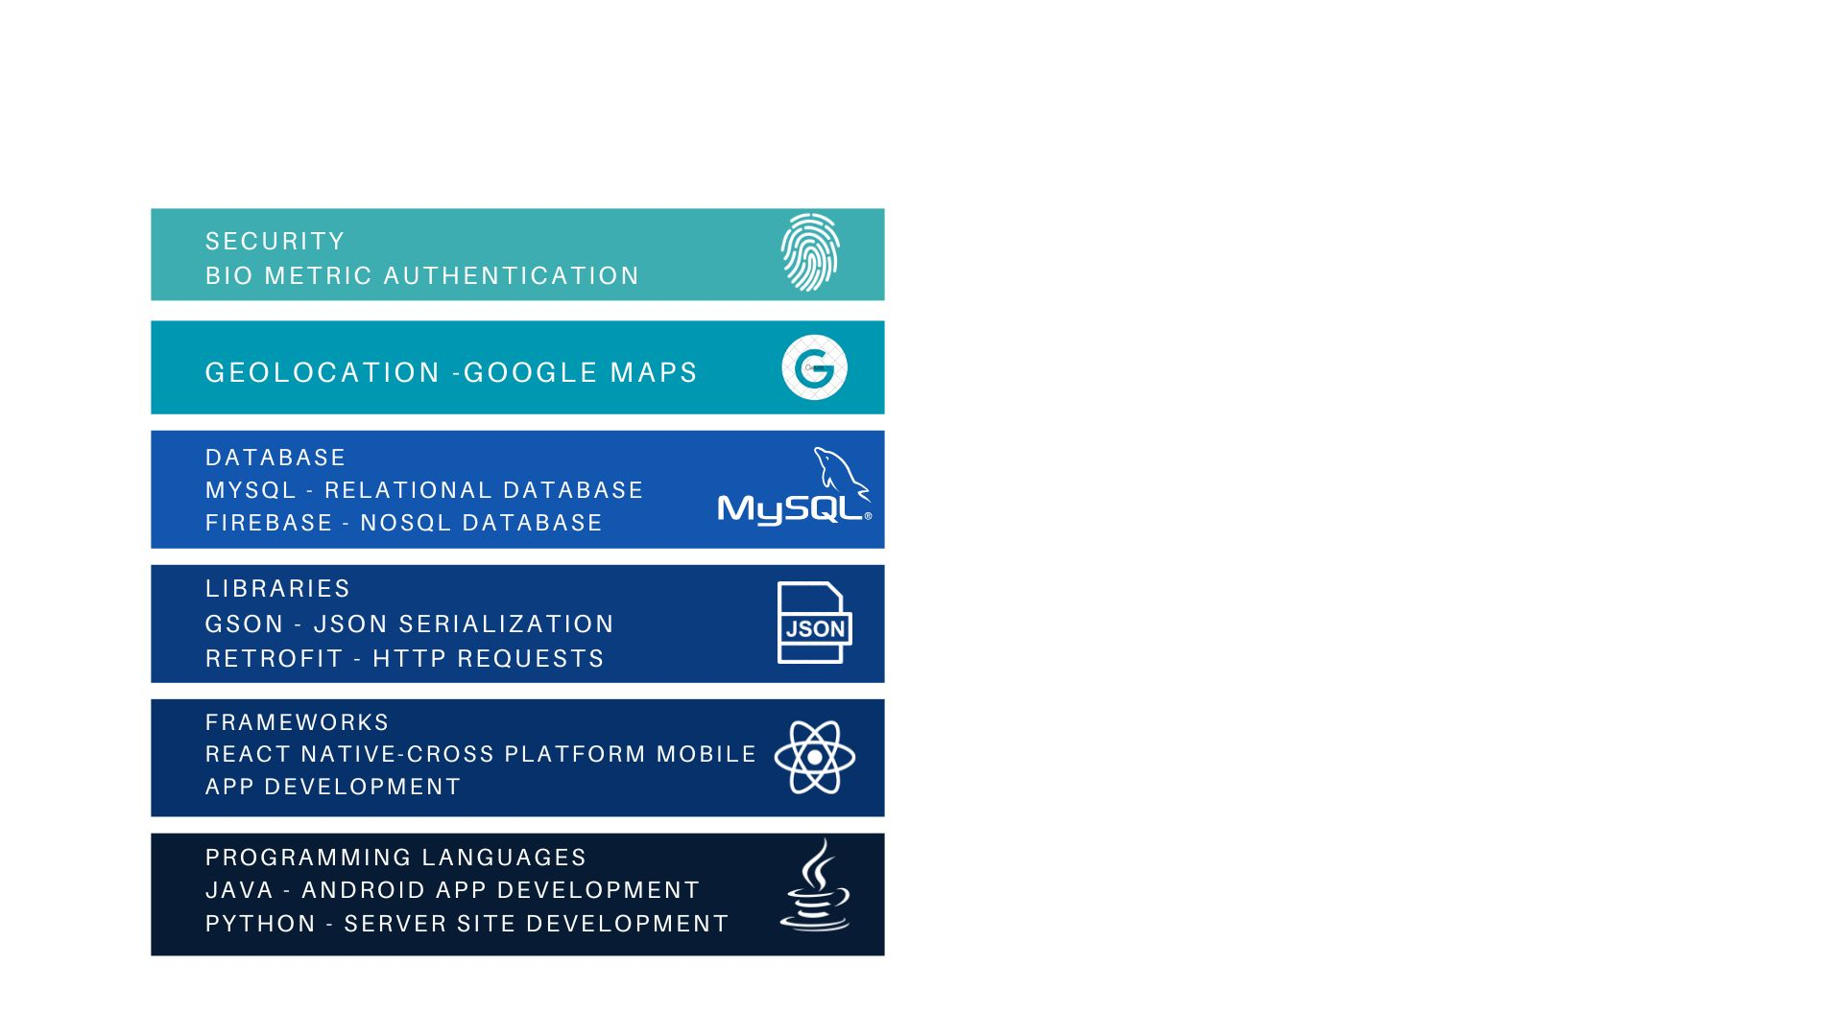
IDEA
MAG-D is the mobile application that uses GPS tracking system with advanced map facilities to keep track of the movements of the officers.
It allows the supervisors to create a login account with their I’d number.
The supervisors can add the officers who are working under them
Hence, the GPS tracker is attached to the badges given to each officers in the bandobast.
The app connects the individual’s tracker to their phone and also it creates a database for each
supervisor which has the details of the officers supervised by him/her...
The app gets the latitude and longitude and loads the map of the place by connecting to the map provided in Google maps.
Once the map of the place is displayed, the supervisor can place the location pointers in the location in which the officer need to perform duty and also enter the radius to which the officer can perform his/her tasks.
When a police officer is out of the location pointers specified then the app alerts the supervisor that the officer is out of their duty area. Also alarm in the badge will be triggered when the device moves outside of a designated area and also when the battery is low.
TECHNOLOGY
STACK

Slide 3
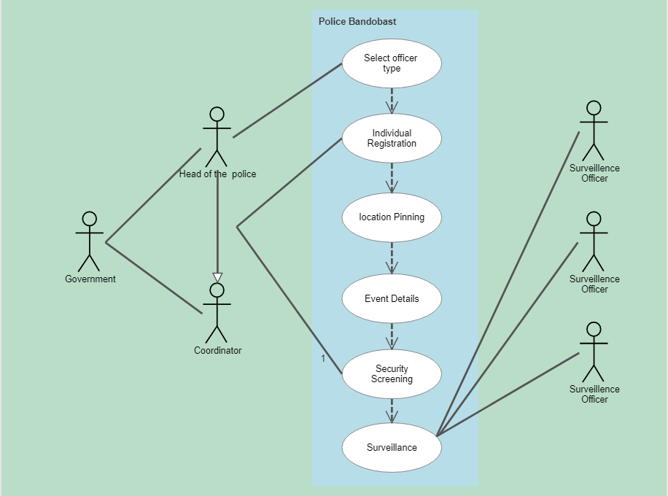
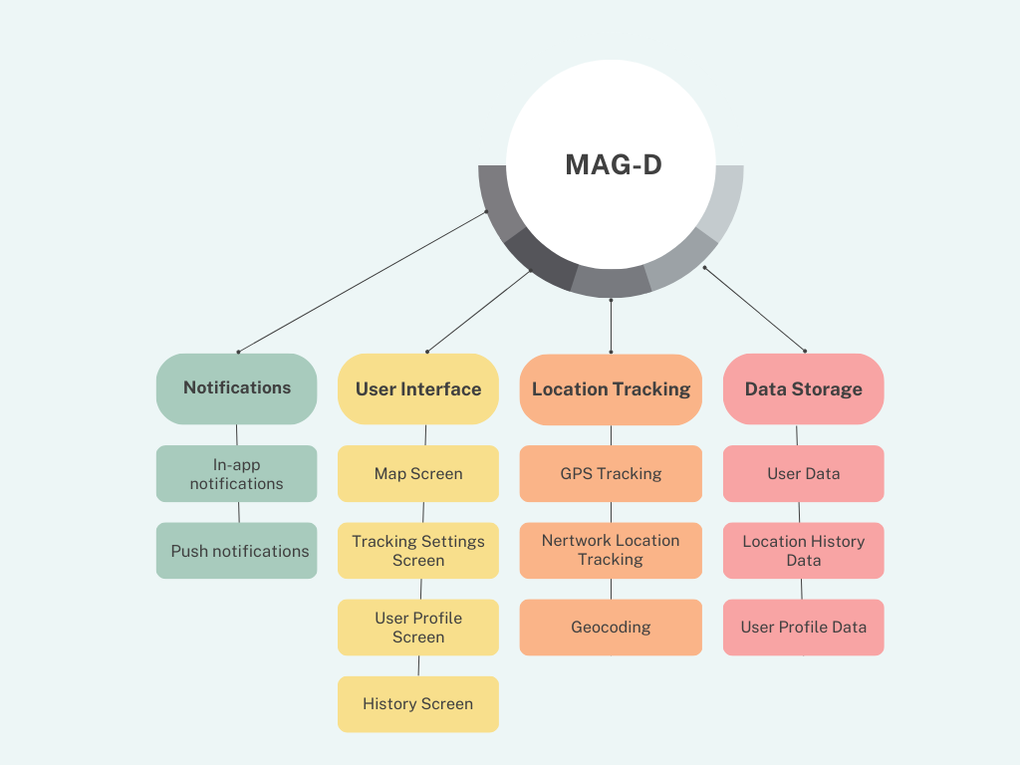
USE CASE DIAGRAM
DEPENDENCY DIAGRAM

Slide 4
Team Member Details
Sr. No. | Name of Team Member | Branch | Stream | Year | Position in team (Team Leader, Front end Developer, Back end Developer, Full Stack, Data base management etc.)
1. | Mithunkumar C | BE | CSE | II | Team Leader
2 | Dinesh S | BE | CSE | II | Designing
3 | Guru Varshini B | BE | CSE | II | Data base management
4 | Dhinesh Karthick V | BE | CSE | II | Front end developer
5 | Abivarman G | BE | CSE | II | Data analyst
6 | Dimple Abirami S | BE | CSE | II | Full Stack
Team Mentor/s Details
Sr. No. | Name of Mentor | Category | Expertise | Domain Experience
1.
2.

